Slide 1
Cyclist Bike-Share
Case Study
By: Shibin Shahid K V
Date: Nov 29, 2022

Slide 2
Table of Contents
The Business task
An overview of customer riding behaviour.
Discuss potential opportunity areas
Appendix

Slide 3
Business Task

Slide 4
Overview of last year of customer riding behaviour
Design strategies to convert casual riders into annual members using digital media by understanding how casual riders and annual members use Cyclistic bikes diﬀerently.

Slide 5
Overview of customer riding behaviour

Slide 6
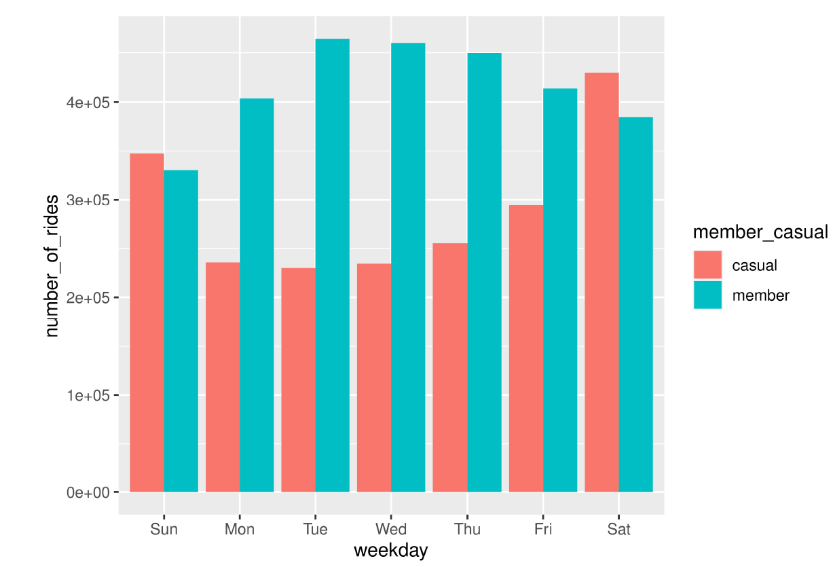
Number of Rides
Saturdays experience the highest number of rides for both casual and member riders.
The number of rides for casual member is less during weekdays.
Riders with an annual memberships tend to ride more times during weekdays.

Slide 7
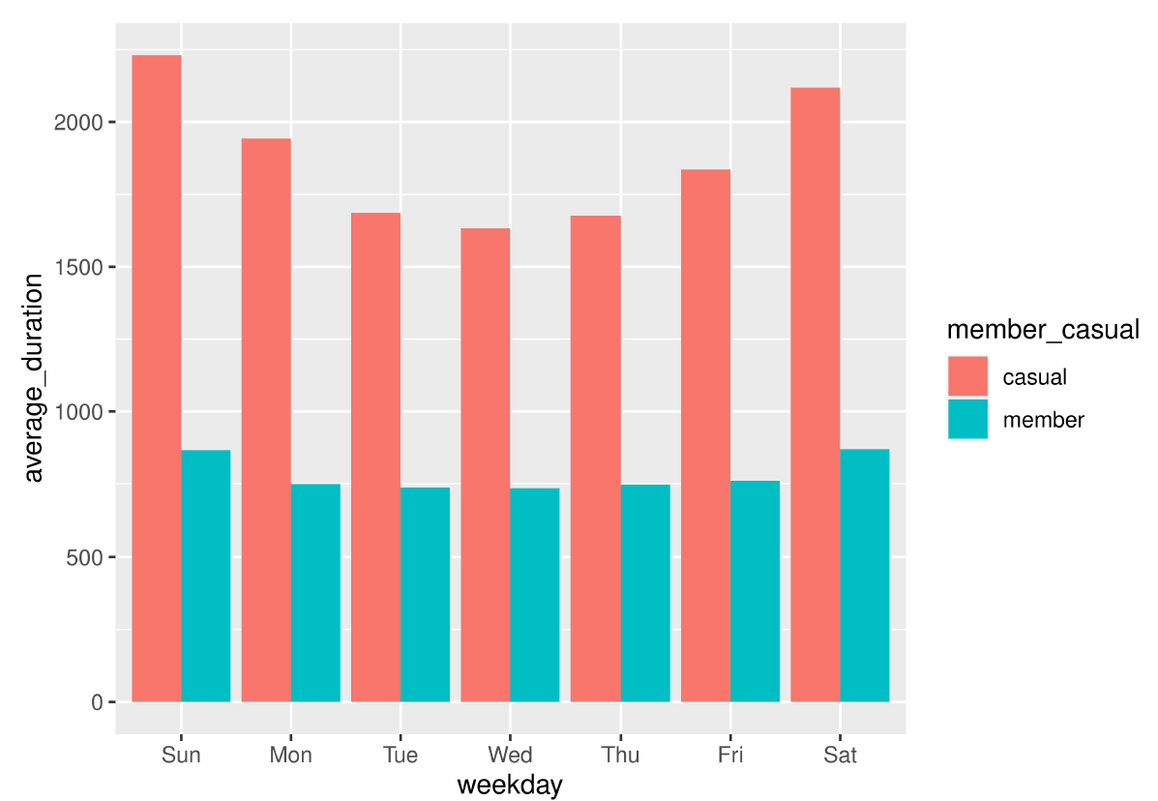
Average Time for Users per Day
The average time for casual members per day is higher than than the average time for members.
Casual: 31.9 min
Members: 12.9 min

Slide 8
Opportunity areas

Slide 9
Average Time for Users per Day
The average time for casual members per day is higher than than the average time for members.
Casual: 31.9 min
Members: 12.9 min

Slide 10
Recommendations
Launch an effective digital marketing campaign on Weekends.
Introduce a commute program to encourage casual riders use bikes through Weekdays.
Offer casual riders discounts on annual memberships based on time used.

Slide 11
Thank you.

